Slide 1
Virtual Memory
Background
Demand Paging
Process Creation
Page Replacement
Allocation of Frames
Thrashing
Operating System Examples

Slide 2
Background
Virtual memory – separation of user logical memory from physical memory.
  Only part of the program needs to be in memory for execution.
  Logical address space can therefore be much larger than physical address space.
  Allows address spaces to be shared by several processes.
  Allows for more efficient process creation.
Virtual memory can be implemented via:
  Demand paging
  Demand segmentation
Operating System Concepts

Slide 3
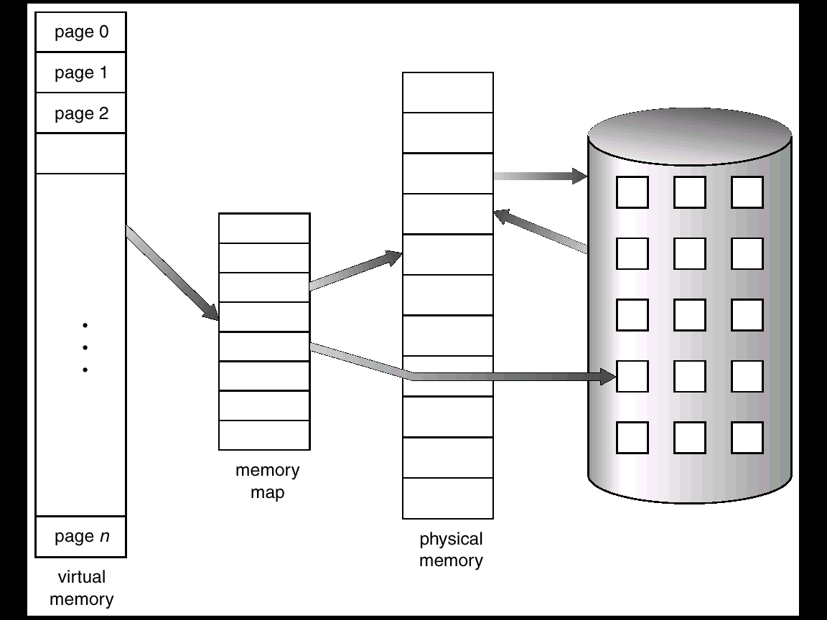
Virtual Memory That is Larger Than Physical Memory
Operating System Concepts

Slide 4
Demand Paging
Bring a page into memory only when it is needed.
  Less I/O needed
  Less memory needed
  Faster response
  More users
Page is needed ⇒ reference to it
  invalid reference ⇒ abort
  not-in-memory ⇒ bring to memory
Operating System Concepts

Slide 5
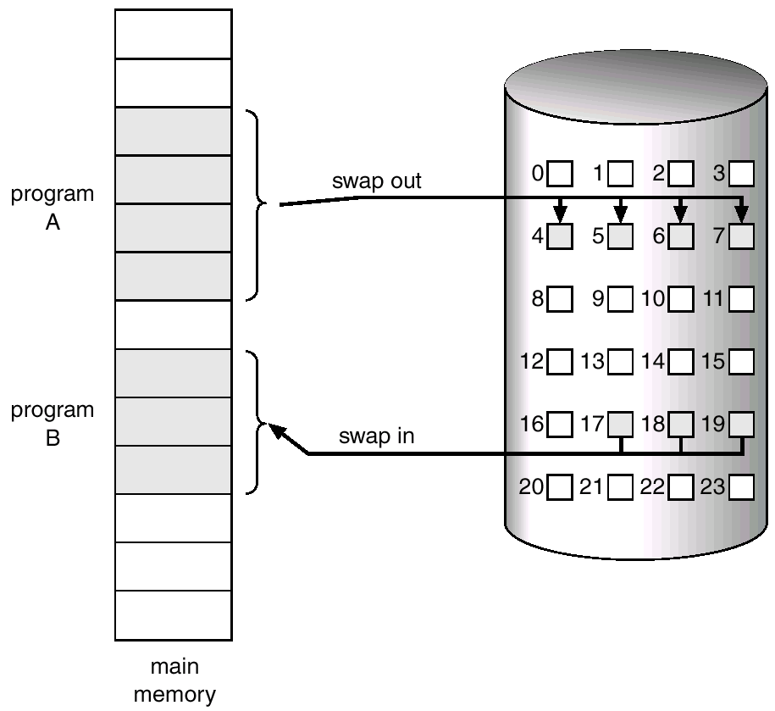
Transfer of a Paged Memory to Contiguous Disk Space
Operating System Concepts

Slide 6
Valid-Invalid Bit
With each page table entry a valid–invalid bit is associated
(1 ⇒ in-memory, 0 ⇒ not-in-memory)
Initially valid–invalid bit is set to 0 on all entries.
Example of a page table snapshot.
During address translation, if valid–invalid bit in page table entry is 0 ⇒ page fault.
Frame #
valid-invalid bit
1
1
1
1
0

0
0
page table
Operating System Concepts

Slide 7

Page Table When Some Pages Are Not in Main Memory
Operating System Concepts

Slide 8
Page Fault
If there is ever a reference to a page, first reference will trap to
OS ⇒ page fault
OS looks at another table to decide:
  Invalid reference ⇒ abort.
  Just not in memory.
Get empty frame.
Swap page into frame.
Reset tables, validation bit = 1.
Restart instruction: Least Recently Used
  block move
  auto increment/decrement location
Operating System Concepts

Slide 9

Steps in Handling a Page Fault
Operating System Concepts

Slide 10
What happens if there is no free frame?
Page replacement – find some page in memory, but not really in use, swap it out.
  algorithm
  performance – want an algorithm which will result in minimum number of page faults.
Same page may be brought into memory several times.

Slide 11
Page Replacement
Prevent over-allocation of memory by modifying page-fault service routine to include page replacement.
Use modify (dirty) bit to reduce overhead of page transfers – only modified pages are written to disk.
Page replacement completes separation between logical memory and physical memory – large virtual memory can be provided on a smaller physical memory.

Slide 12
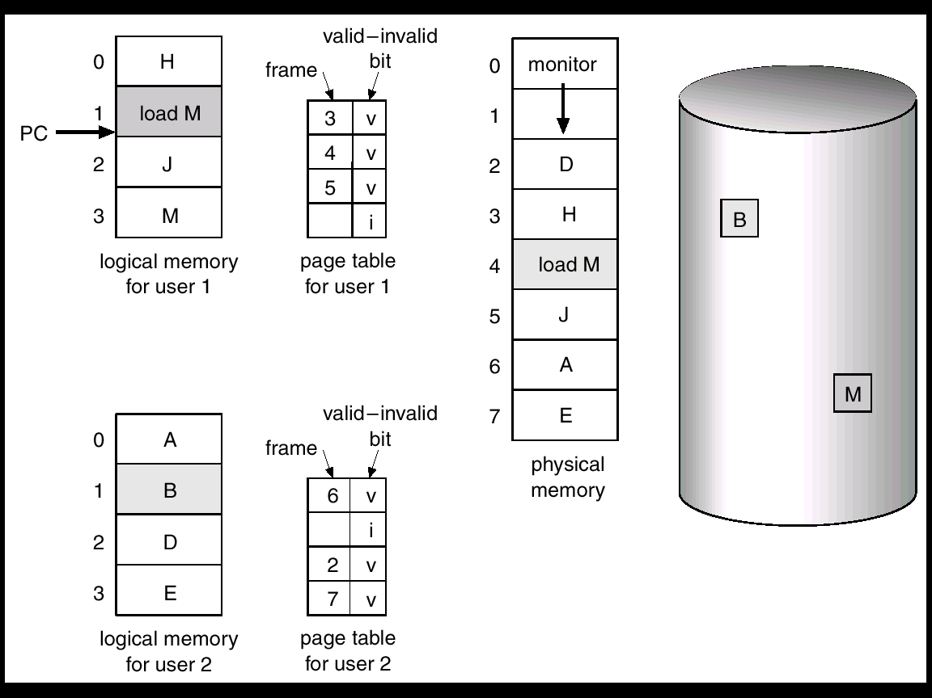
Need For Page Replacement

Slide 13
Basic Page Replacement
Find the location of the desired page on disk.
Find a free frame:
- If there is a free frame, use it.
- If there is no free frame, use a page replacement algorithm to select a victim frame.
Read the desired page into the (newly) free frame. Update the page and frame tables.
Restart the process.

Slide 14

Page Replacement

Slide 15
Page Replacement Algorithms
Want lowest page-fault rate.
Evaluate algorithm by running it on a particular string of memory references (reference string) and computing the number of page faults on that string.
In all our examples, the reference string is
7 0 1 2 0 3 0 4 2 3 0 3 2 1 2 0 1 7 0 1

Slide 16
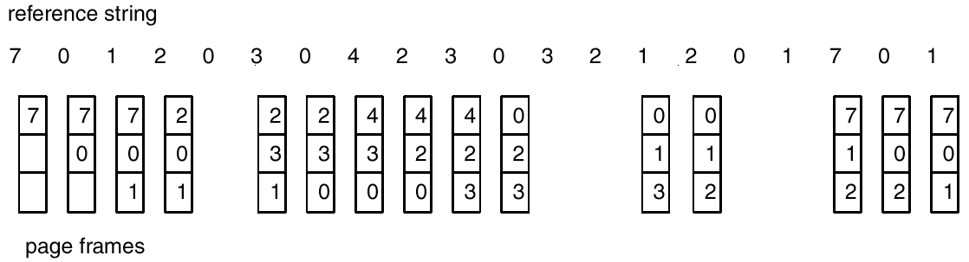
FIFO Page Replacement

Slide 17
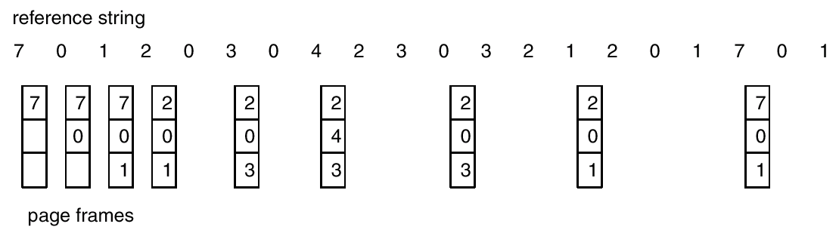
Optimal Algorithm
Replace page that will not be used for longest period of time.

Slide 18
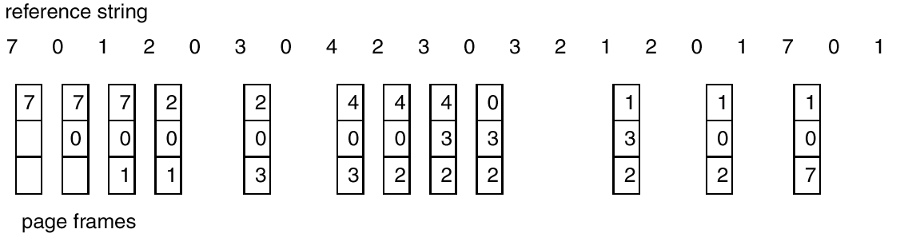
LRU Page Replacement

Slide 19
Counting Algorithms
Keep a counter of the number of references that have been made to each page.
LFU Algorithm: replaces page with smallest count.
MFU Algorithm: based on the argument that the page with the smallest count was probably just brought in and has yet to be used.

Slide 20
Thrashing
If a process does not have “enough” pages, the page-fault rate is very high. This leads to:
  low CPU utilization.
  operating system thinks that it needs to increase the degree of multiprogramming.
  another process added to the system.
Thrashing ≡ a process is busy swapping pages in and out.

Slide 21

Thrashing (Cont.)

Slide 22
Demand Paging and Thrashing
Why does demand paging work?
Locality model
  Process migrates from one locality to another
  Localities may overlap
Why does thrashing occur?
Σ size of locality > total memory size
  Limit effects by using local or priority page replacement

Slide 23

Locality In A Memory-Reference Pattern

Slide 24

Working-Set Model
Δ ≡ working-set window ≡ a fixed number of page references
Example: 10,000 instructions
WSS_{i} (working set of Process P_{i}) =
total number of pages referenced in the most recent Δ (varies in time)
  if Δ too small will not encompass entire locality
  if Δ too large will encompass several localities
  if Δ = ∞ ⇒ will encompass entire program
D = Σ WSS_{i} ≡ total demand frames
  Approximation of locality
if D > m ⇒ Thrashing
Policy if D > m, then suspend or swap out one of the processes

Slide 25
Keeping Track of the Working Set
Approximate with interval timer + a reference bit
Example: Δ = 10,000
  Timer interrupts after every 5000 time units
  Keep in memory 2 bits for each page
  Whenever a timer interrupts copy and sets the values of all reference bits to 0
  If one of the bits in memory = 1 ⇒ page in working set
Why is this not completely accurate?
Improvement = 10 bits and interrupt every 1000 time units

Slide 26

Page-Fault Frequency
More direct approach than WSS
Establish “acceptable” page-fault frequency (PFF) rate and use local replacement policy
  If actual rate too low, process loses frame
  If actual rate too high, process gains frame

